Slide 1

Logistic Regression Analysis of Coronary Heart Disease Risk
Martin Banghart - Mobolaji Shobanke - Raffa Nimir - Ashhwath Chandramohan
EMSE 6574 - Professor Maksim Tsvetovat
December 12th, 2022

Slide 2
Introduction
16 Features
Data came from extensive NIH study involving the physical examination and lifestyle interviews of adults in Framingham, MA to
link factors to Coronary Heart Disease - the leading cause of death in the United States (afflicting approximately 18.2 million american adults)
Explanatory Variables : Male, Age, Education, CurrentSmoker, CigsPerDay, BPmeds,PrevalentStroke, PrevalentHyp, Diabetes, TotChol, sysBP, diaBP, BMI, HeartRate, Glucose
Dependent Variable : TenYearCHD
15 Independent Variables
Referenced : https://www.nhlbi.nih.gov/health/coronary-heart-disease

Slide 3
What do we mean by TenYearCHD?
Definition
The potential risk to contract Coronary Heart disease within a ten year time frame
Representation in Dataset
TenYearCHD is a random, binary variable. Therefore, An individual either has risk (1) or does not (0) . Understanding this is crucial to the prediction of the Regression Model.

Slide 4
Project Scope
Build a Logistic Regression model from scratch
Predict the Risk of Coronary Heart disease (TenYearCHD)
Compare Results to Python Existing Library - SKlearn

Slide 5
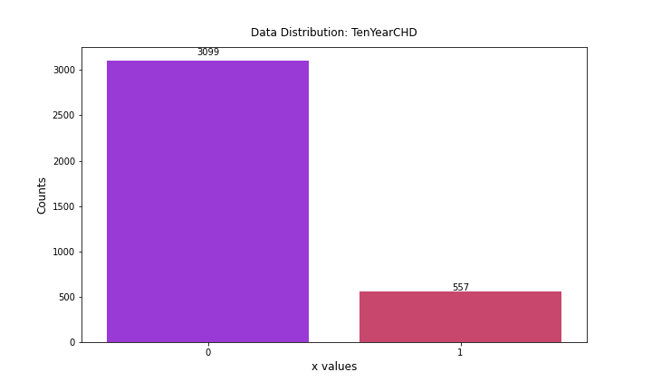
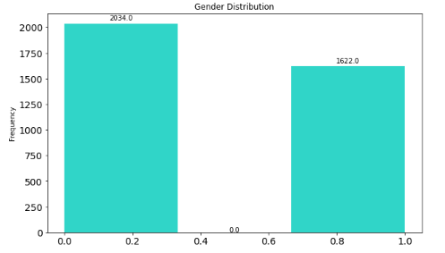
Data Overview
Original Data Consists of 4239 records
Cleaned Data by dropping NA values reduces records to 3656
TenYearCHD distribution consists of 3099 people with no risk and 557 positive cases

Slide 6

Logistic Regression Build

Slide 7
Code Improvements
Fit Function
The result from running a while loop while optimizing the coefficients is a gain in accuracy at a loss of model runtime.
Ultimately, will prove difficult in operation if data is scaled up
Learning Rate
Cost Function
Gradient Descent Optimization
WHILE LOOP
I

Slide 8
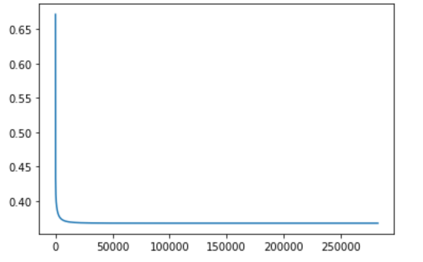
Loss Function Graph
The function runs until it reaches the minimum cost function value where the best coefficients for the regression have been determined
Value of Cost Function
Number of Iterations

Slide 9
Feature Selection

Slide 10
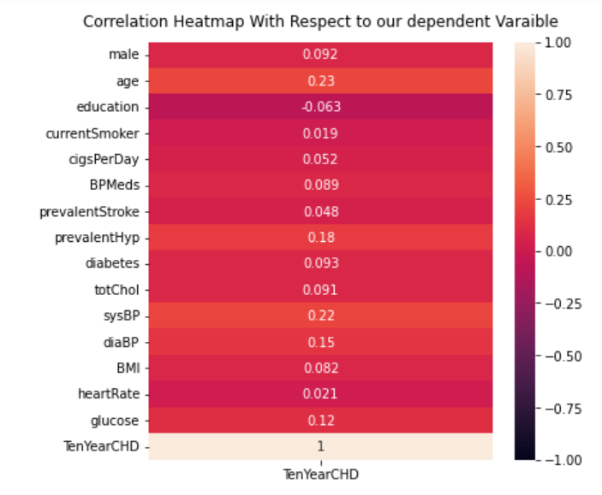
Correlation Matrix
All explanatory variables appear to have very low correlation values
Considering the Log(Odds) equation for the L.R Model is linear, some dependence between the X variables and Y Variable would be preferred. However, all variables of X must be independent of each other

Slide 11
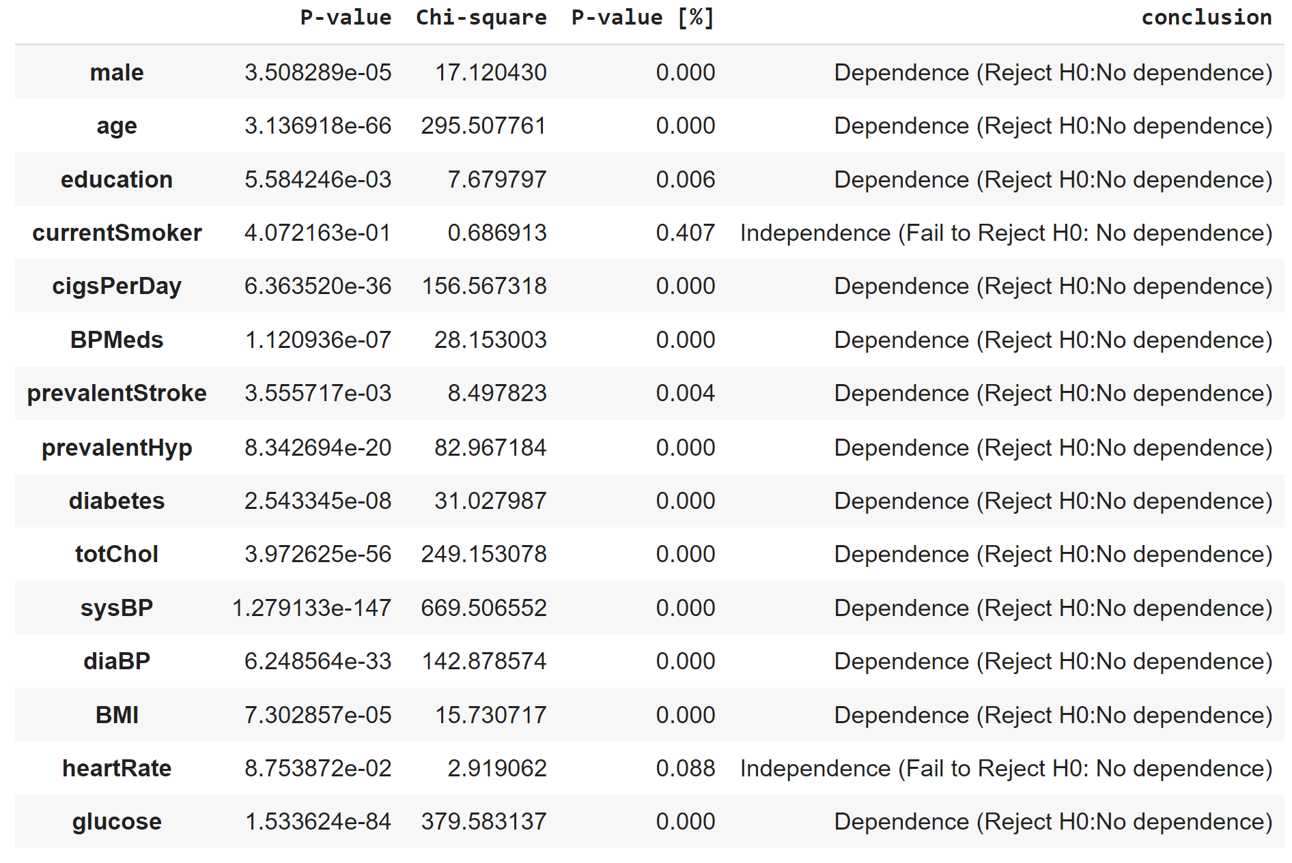
Chi-Square Evaluation of Variables
Null hypothesis
The explanatory variable is independent of the dependent variable
Alternative Hypothesis
There is dependency between the explanatory and dependent variable

Slide 12
Model Prediction

Slide 13
Initial Model
Train Test Split (70/30)
Utilizing all variables, excluding CurrentSmoker and HeartRate - as derived from Chi - Square Test
Threshold : 0.5
 | Actual Positive | Actual Negative
Predicted Positive | 15 | 10
Predicted Negative | 159 | 913
 | Our Model | Sklearn
Fscore | 0.15075 | 0.13471
Confusion Matrix (from Model)

Slide 14
Second Model Using 20% Appr. Threshold
Train Test Split (70/30)
Utilizing all variables, excluding CurrentSmoker and HeartRate
Threshold : 0.2
 | Actual Positive | Actual Negative
Predicted Positive | 85 | 177
Predicted Negative | 89 | 746
 | F1_Score
Our Model | 0.3899
Confusion Matrix (From Model)

Slide 15
Model Comparison

Slide 16
Model 1 vs. Model 2
0.5 (Probability Threshold)
 | Actual Positive | Actual Negative
Predicted Positive | 15 | 10
Predicted Negative | 159 | 913
 | Our Model | Sklearn
Fscore | 0.15075 | 0.13471
0.2 ( Probability Threshold)
 | Actual Positive | Actual Negative
Predicted Positive | 85 | 177
Predicted Negative | 89 | 746
 | F1_Score
Our Model | 0.3899
Although the F_score increased from 15.07% to 38.99%, the number of False Positives also Increased from 10 to 177!

Slide 17
Could There Be Bias in the Probability Estimation of the Regression Model?
Data Exploration

Slide 18
Causes of Coronary Heart Disease
Smoking (and Secondhand Smoke Exposure)
High Blood Pressure
High-Low-Density Lipoprotein (LDL) cholesterol
Diabetes
Obesity (unhealthy diet, low physical activity)
Referenced : https://www.cdc.gov/chronicdisease/resources

Slide 19
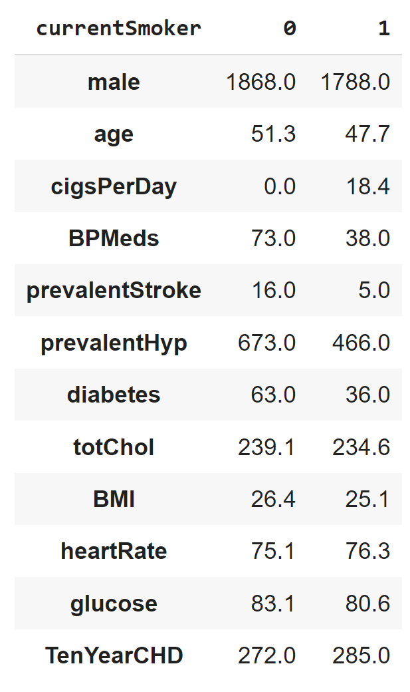
Visual Observation of the Association Between Smoking & TenYearCHD
There are 1868 non-smokers and 1788 smokers
There are 272 non smokers with TenYearCHD & 285 smokers with TenYearCHD
The median age in the group of non-smokers approximately 51
The median age in the group of smokers is approximately 47
There are more nonsmokers on BPMeds than smokers on BPMeds
There are non-smokers with prevalent hypertension and stroke than smokers

Slide 20
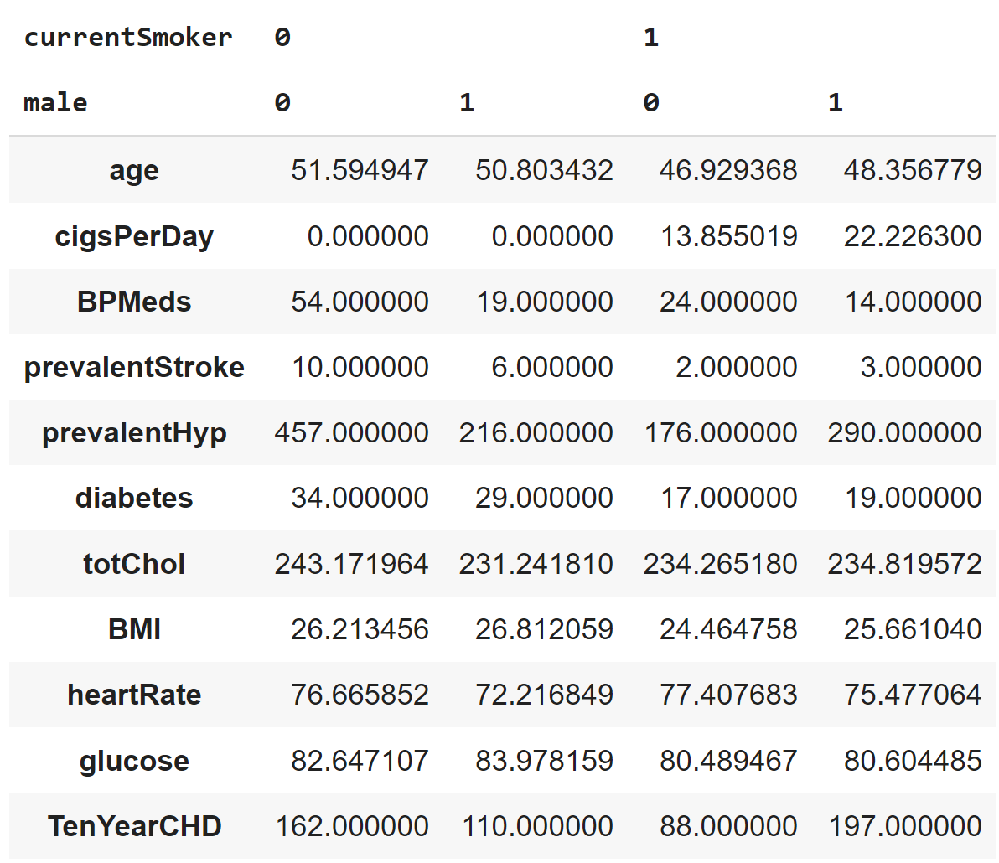
Grouping Smokers by Gender
From the data, male patients younger than 50 who smoke had a higher risk of TenYearCHD than male patients over 50 who do not smoke.
In contrast, female patients above 50 that don't smoke have a higher number of TenYearCHD compared to females below 50 who smoke
Consider females above the age of 50 who don’t smoke and males younger than 50 and smoke, 1st group has more patients on BPMeds compared to the latter, which has the less amount of people on BPMeds

Slide 21
Could Age and Gender be Influencing the Relationship between Smoking & TenYearCHD?
Confounding!

Slide 22
Direct Acyclic Graph
Collider
Confounder
Exposure
Outcome
Mediator

Slide 23
Identification of Confounding Variables
The Confounding factor must be associated with both the risk factor of interest and the outcome
The confounding factor must be distributed unequally among the groups being compared
A confounder cannot be an intermediary step in the causal pathway from the exposure of interest to the outcome of interest

Slide 24
Causal Pathway (Smoking → TenYearCHD) Direct Acyclic Graph
Gender
Age
currentSmoker
TenYearCHD
currentSmoker
TenYearCHD

Slide 25
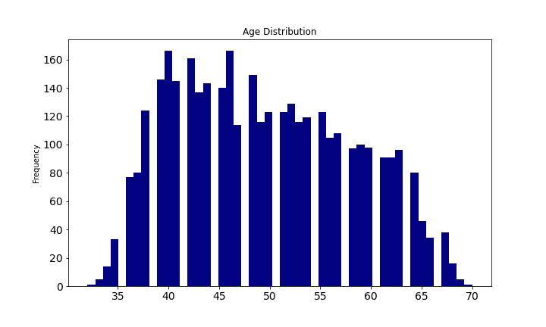
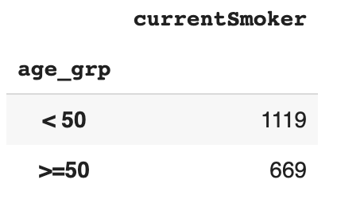
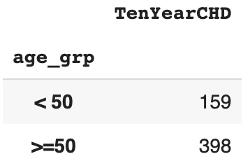
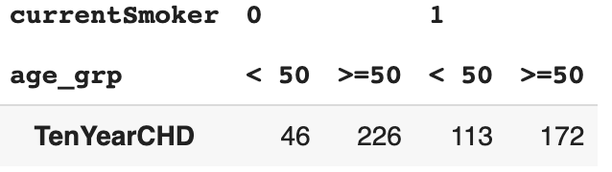
Association Between Age, Smoking and TenYearCHD

Slide 26
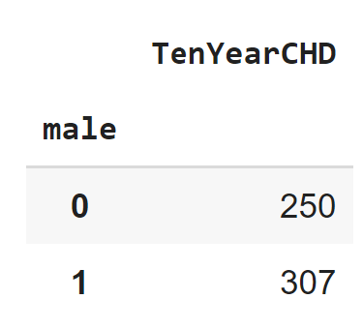
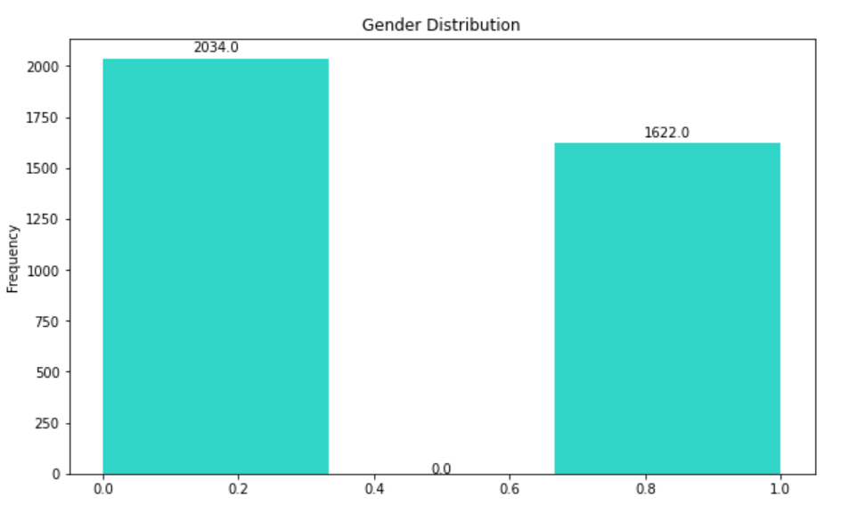
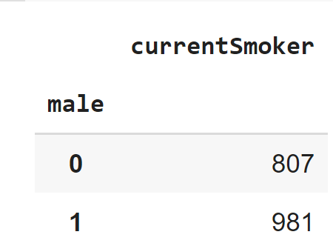
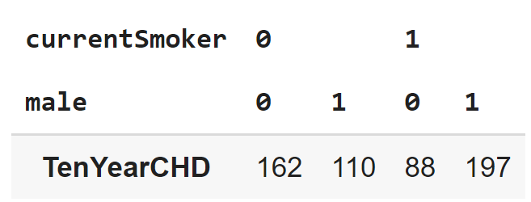
Association Between Gender, Smoking and TenYearCHD

Slide 27
Measure of Association

Slide 28
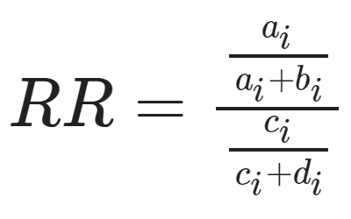
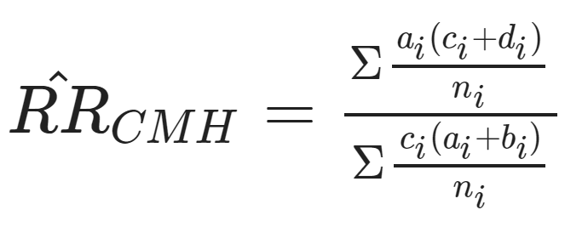
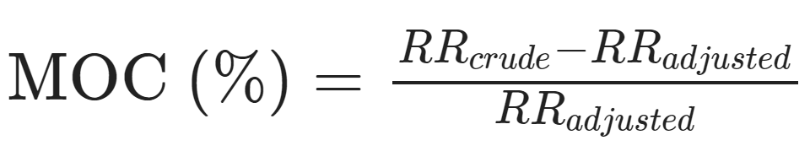
Risk-Ratio & Magnitude of Confounding
Measure of Association (and or Risk Ratio) quantifies the relationship between exposure (cause) and outcome (effect) among two groups.
Risk Ratio compares the risk of a event in one group with the risk among another group. It is the ratio of the probability of an outcome in one group relative to another.
Magnitude of Confounding is the percentage difference between the crude and adjusted measure of association for confounding.

Slide 29
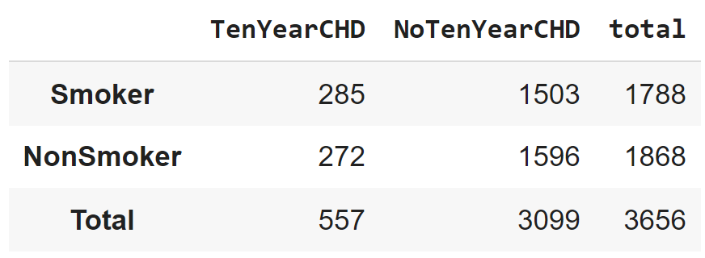
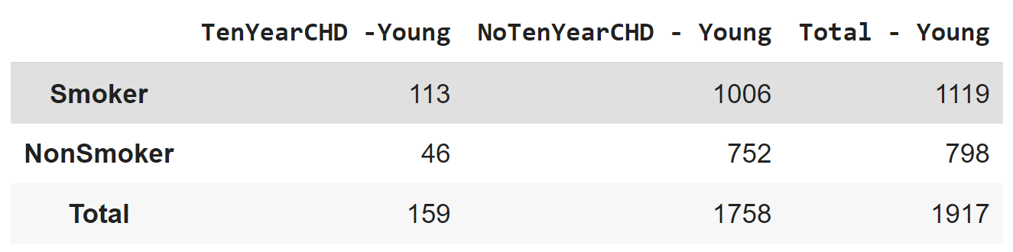
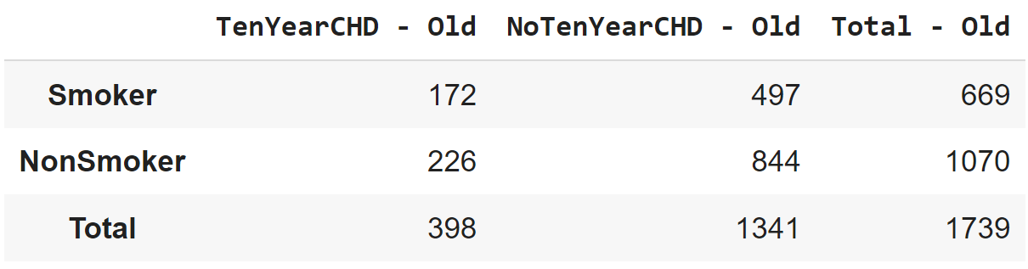
Crude & Strata-Specific RR for Age
Strata | Risk Ratio
Crude | 1.09
Young (<50) | 1.75
Old (>= 50) | 1.22

Slide 30
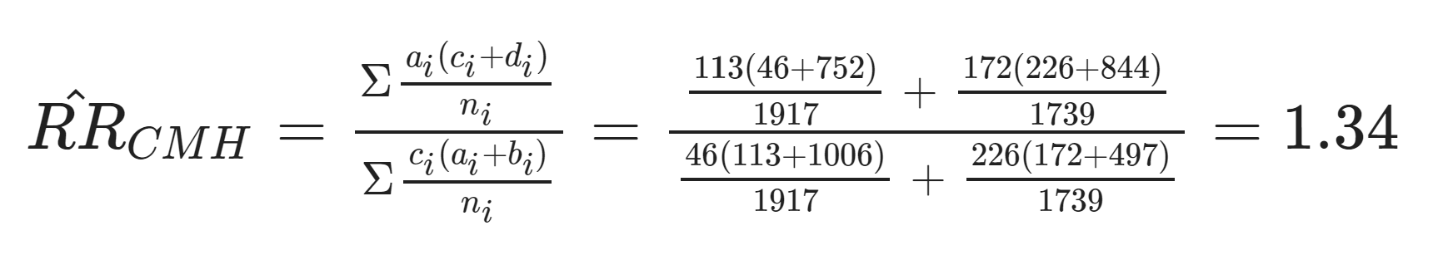
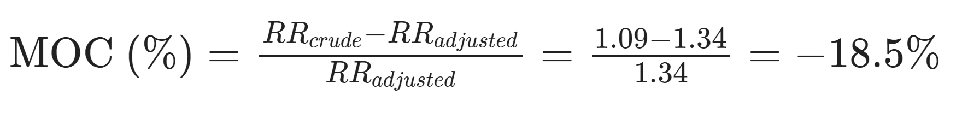
Adjusted Risk Ratio & Magnitude of Confounding (Age)
The adjusted Risk Ratio is derived from the Cochran-Mantel-Haenszel Formula
The Cochran-Mantel-Haenszel is a technique that generate an estimate of an association between an exposure and an outcome after adjusting for or taking into account confounding.
In simpler term, it is the weighted averages of of the stratum-specific estimates

Slide 31
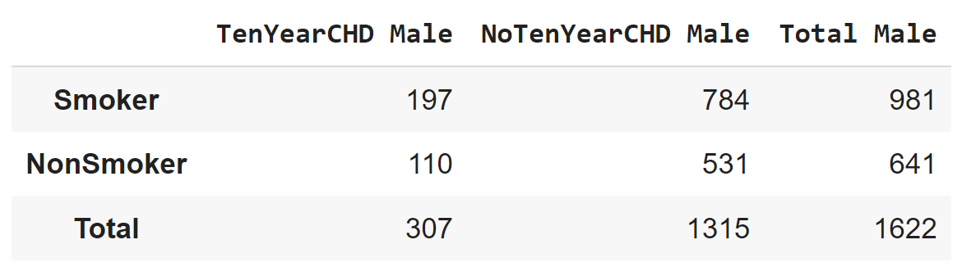
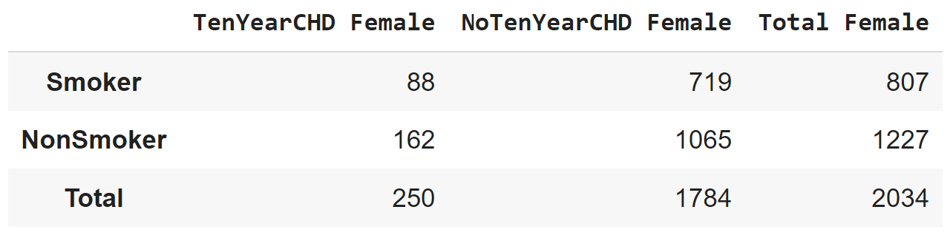
Crude & Strata Specific RR for Gender
Strata | Risk Ratio
Crude | 1.09
Male | 1.17
Female | 0.826

Slide 32
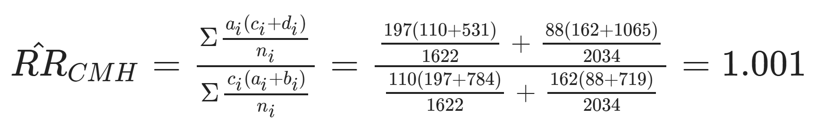
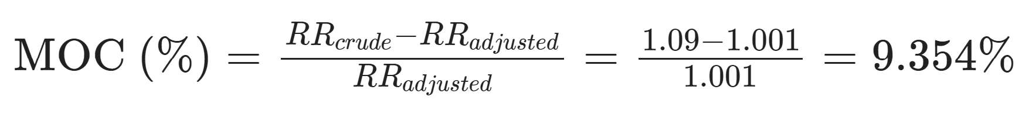
Adjusted Risk Ratio & Magnitude of Confounding (Gender)
Age is a confounding variable that creates an underestimation of the association between Smoking and TenYearCHD
Gender is a confounding variable that causes slight overestimation of the association between Smoking and TenYearCHD

Slide 33
Summary & Team Assumption

Slide 34
Summary
Variables “Age” and “Male” create bias in the estimate of the relationship between the Exposure Variables and TenYearCHD. As a result, we cannot accurately select the features that are true predictors for our regression model, therefore affecting the accuracy of our result.

Slide 35
Team Assumption
In order to improve our F_score, we will need to do the following:
Process the data further and group the features per record into the different Exposure variables identifiable in the data.
Individually assess and control the effect of confounders on other Exposure variables, such as BMI(obesity), SysBP/DiaBP, and BPMeds (Blood Pressure), e.t.c, using stratification
Ultimately, we believe that the actual variables for the predictors of our regression model will be probability values, given the classification of exposure of an individual under each predictor. In this case, the probability values of exposed individuals will be multiples of the probabilities of TenYearCHD occurrence of unexposed individuals in each predictor variable.

Slide 36
Biggest Take-Away

Slide 37


Slide 38
GitHub and Medium Post
GitHub: https://github.com/martinbolaji/Logistic-Regression-Analysis-of-Coronary-Heart-Disease-Risk.
Medium:
https://medium.com/@teamemse2022/logistic-regression-classification-for-coronary-heart-disease-dataset-1c3d1277b167

